Slide 1
Task- 2

Slide 2
Vulnerabilities found in a website
The vulnerabilitites found in a website which is “ https://zero.webappsecurity.com”
By giving this website name in the search bar it takes time to find the vulnerabilitites nearly 1 or 2 hours.
The vulnerabilities which we found will return in such a way that
1. Low risk items
2. Medium risk items
3. High risk items
4. Critical risk items

Slide 3
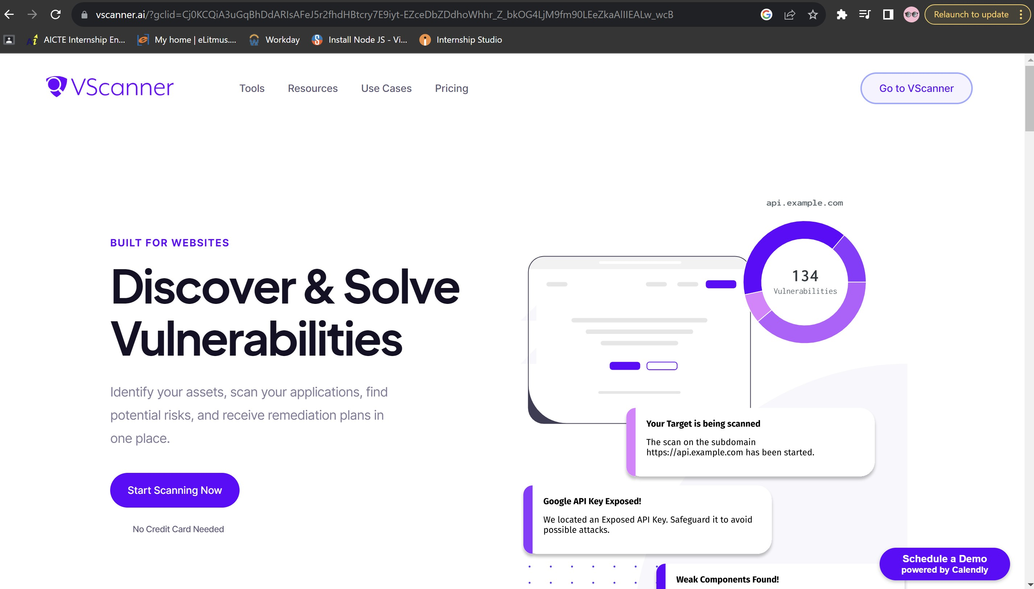
In which netsparker the vulnerabilities are generated, it is “Vscanner”

Slide 4
The vulnerabilities which I got after scanning the website
In this website there are nearly eleven vulnerabilities were found, among them there are 10 medium risk vulnerabilities and one low risk vulnerability and there are no high risk and critical risk vulnerabilities were found.
Now let see the medium risk vulnerabilities which are found in this website,
Spoofing, misconfiguration and generic_cve these are categories.
In spoofing we can see “Email spoofing is the creation of email messages with a forged sender address. The term applies to email purporting to be from an address which is not actually the sender's; mail sent in reply to that address may bounce or be delivered to an unrelated party whose identity has been faked. Assistant: ['http://zero.webappsecurity.com has no SPF record!', 'No DMARC record found. Looking for organizational record', 'No organizational DMARC record’].
Solution: Set up DMARC, DKIM, and SPF for email security. DMARC requires creating a record in your domain's DNS, detailing report address and message failure policy. DKIM involves generating a public/private key pair, publishing the public key in DNS as a TXT record, and configuring your email server to sign messages with the private key. SPF requires creating a DNS record that lists authorized email servers for your domain. Setup can vary with different email server software and hosting providers; check your specific setup's documentation.

Slide 5
In misconfiguration we can see” Failure to use X-Content-Type-Options header could allow an attacker to spoof a certain type of file that would be analyzed through MIME type detection, which could confuse the browser from its actual validation, where it would lead to the execution of other vulnerabilities such as Cross-site scripting. When a file does not have enough information to determine its origin, such as the presence of metadata, browsers determine the extension of that file, from its contents. This type of behavior can become a security risk, if the browser misinterprets a given file in some form of uploading files, for example, a JPEG file could have been misinterpreted, if the content of your file existed HTML tags and Javascript codes, instead of the browser treating this extension as a corrupted image, would execute the codes typed by the user or in a malicious way by falsifying a victim's request, after clicking a fake link or visiting a website controlled by an attacker Solution: Implement the X-Content-Type-Options header in the server response.

Slide 6
In generic_cve we can see” jQuery before 1.9.0 is vulnerable to Cross-site Scripting (XSS) attacks. The jQuery(strInput) function does not differentiate selectors from HTML in a reliable fashion. In vulnerable versions, jQuery determined whether the input was HTML by looking for the '<' character anywhere in the string, giving attackers more flexibility when attempting to construct a malicious payload. In fixed versions, jQuery only deems the input to be HTML if it explicitly starts with the '<' character, limiting exploitability only to attackers who can control the beginning of a string, which is far less common. Solution: Update the software to the latest version

Slide 7
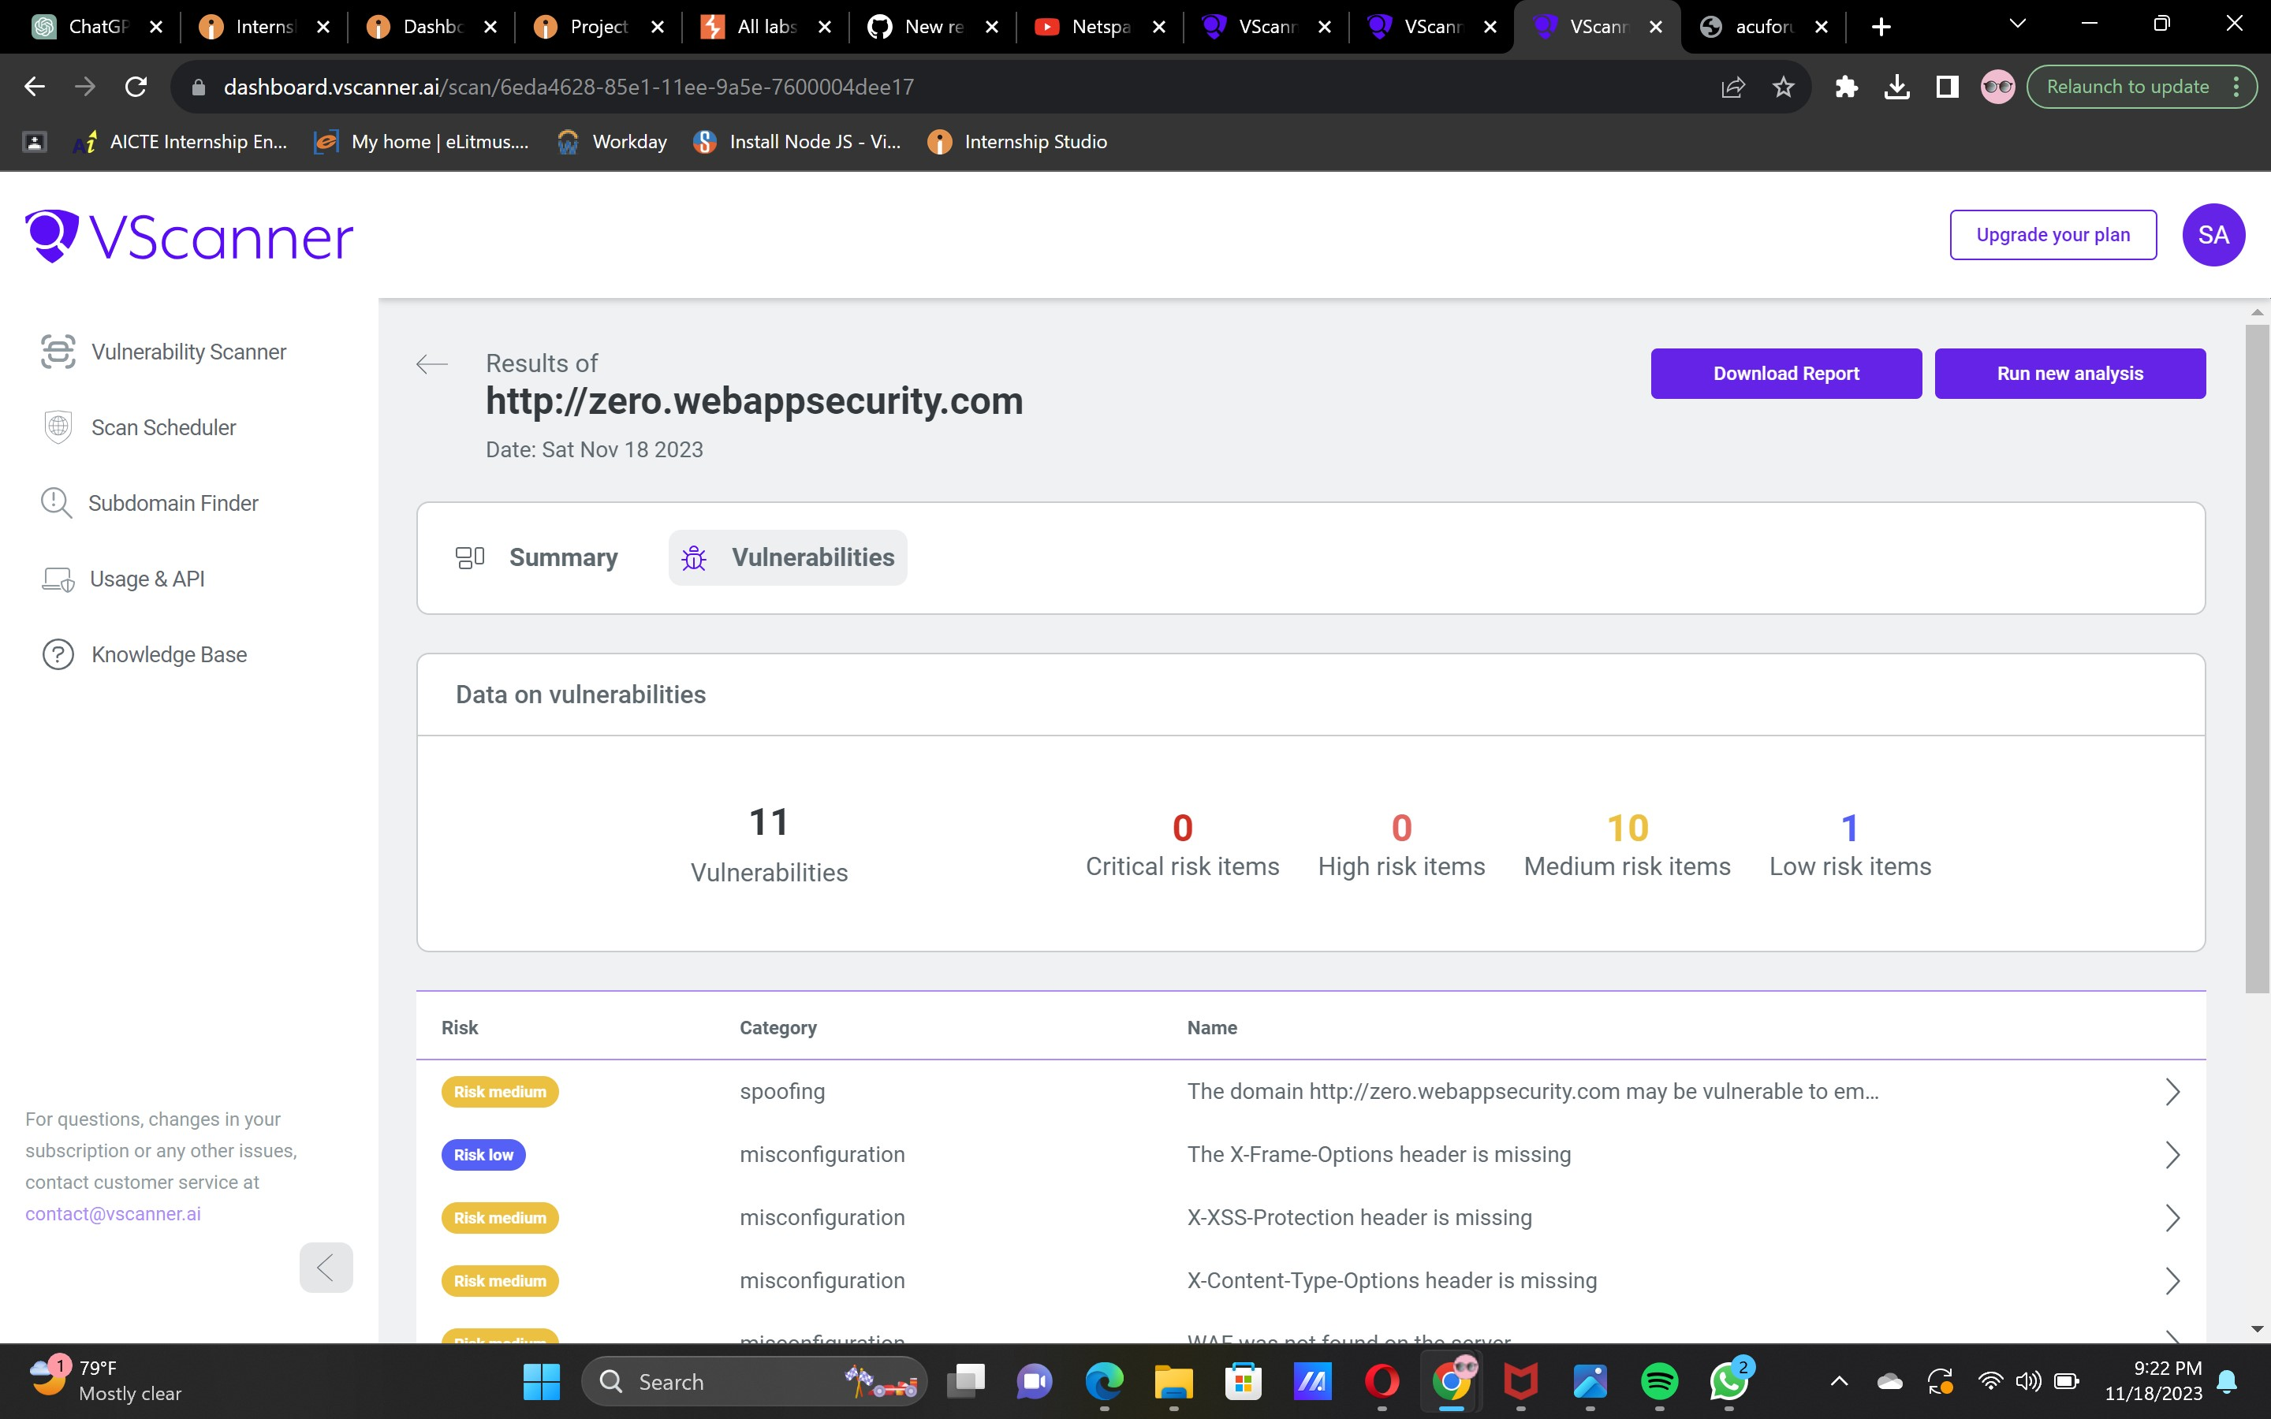

Slide 8
Lastly about low risk vulnerability which is misconfiguration. In this misconfiguration we can see “The lack of the X-Frame-Options header in the response from the Web application server, makes it possible to hijack on the user's click, where through a malicious indexing of a page on an attacker's website, it could allow the hiding of this domain through an overlay, causing involuntary actions performed by a victim in the background. This type of exploit could make other security vulnerabilities even more serious, such as turning a self-XSS into a reflected one. Self-XSS occurs when a certain user input field is not properly filtered, this type of exploitation that, in theory, would only happen on the attacker's computer and would have to require a lot of interaction from the victim to happen, in addition to just clicking or visiting the page as in other cases, however, the user click hijacking ends up hiding from the victim's eyes what he actually ends up doing, this exploration can end up triggering what would simply be a self-XSS without any security impact, for a conventional one, such as the reflected one. Solution: The X-Frame-Options is an HTTP response header that aids in preventing clickjacking attacks by regulating how a website is rendered on another site's frame, iframe, or object. It has three potential values: 'SAMEORIGIN' (allows rendering on the same domain only), 'DENY' (blocks rendering on any origin), and 'ALLOW-FROM uri' (permits rendering only on a specified origin). To apply X-Frame-Options, add it to the HTTP response on your web server. The implementation varies with the web server software. For example, in Apache, add "Header set X-Frame-Options 'SAMEORIGIN'" to the .htaccess file. The 'SAMEORIGIN' value is advised for most websites, allowing intra-domain framing but blocking inter-domain ones.

Slide 9
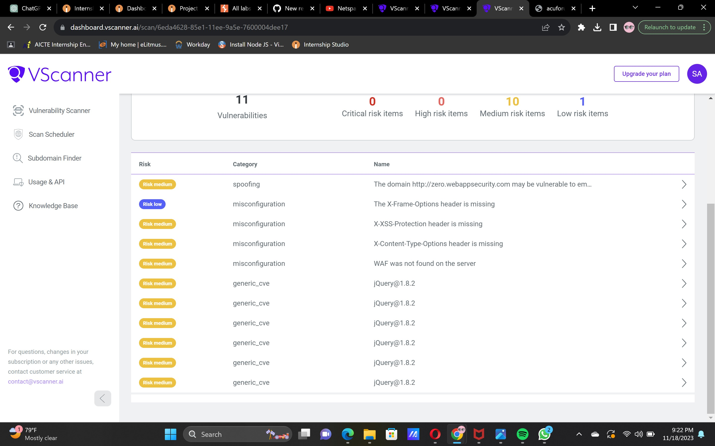

Slide 10
Thank you…..

